Slide 1
SOP for Configuring Auto-mail Alarm
October 2013

Slide 2
SOP for Configuring Auto-mail Alarm
Open PecConfig.
Choose the Station and click Alarm Rule Setup.
Press Add Node.

Slide 3
SOP for Configuring Auto-mail Alarm
The Alarm Condition Properties window shows up.
Set the following settings:
Alarm Point: Set as default.
Alarm Class(Alarm/Other/Fault/Normal)
Action Type(Greater than/Less than)
Type (Analog setpoint/Device setpoint/Digital change)
Site, Device and Source.
Logged (Record by Software/Record by Device)
High Limit and Low limit.
Action Delay and Return Delay.
Press OK.

Slide 4
SOP for Configuring Auto-mail Alarm
Click Email Auto-send Configuration and press Properties.

Slide 5
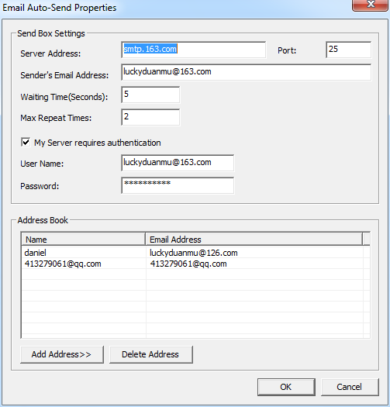
SOP for Configuring Auto-mail Alarm
Server Address and port number can be found in the mail service website.
Port number is non-SSL protocol port number.
Type in Sender’s Email Address, Waiting Time and Max Repeat Time.
Check My Server requires authentication and type in User Name and Password.
Press Add Address>> and type in Name and Email Address to add in Address Book.
Press OK.

Slide 6
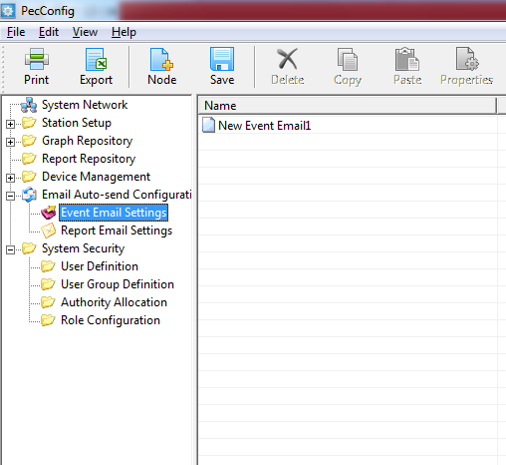
SOP for Configuring Auto-mail Alarm
Click Event Email Settings and press Add Node.

Slide 7
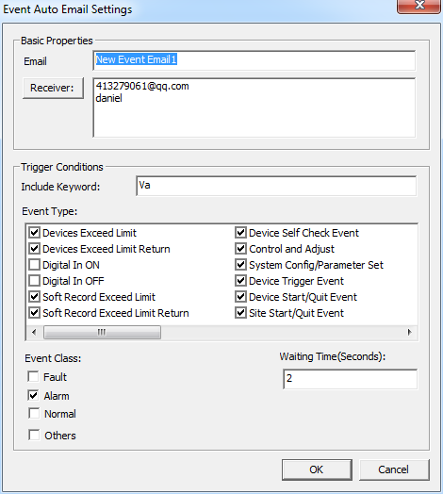
SOP for Configuring Auto-mail Alarm
Email is the Title of the sending email.
Receiver is the email address in the address book.
Event Type is to choose the event that trigger to send email.
Event Class include Fault. Alarm, Normal and Others. It should be the same as the Alarm Class in Alarm Rule Setup.
Default Waiting Time is 60 seconds, change to a smaller number.
Press OK.
NOTE: Cannot check all the Event Type or Event Class, otherwise, all the types or class will be unchecked. Please reopen this window to make sure all the settings are correct because there is no textbox to remind you.

Slide 8
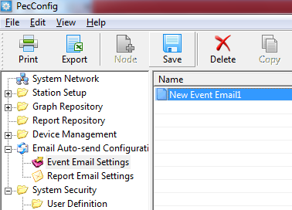
SOP for Configuring Auto-mail Alarm
After all the above configuration done, press Save.

Slide 9
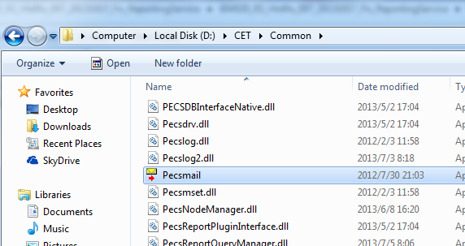
SOP for Configuring Auto-mail Alarm
Open Pecsmail.exe in the PecStar installation directory
(Default:D:\CET\Common\Pecsmail.exe)

Slide 10
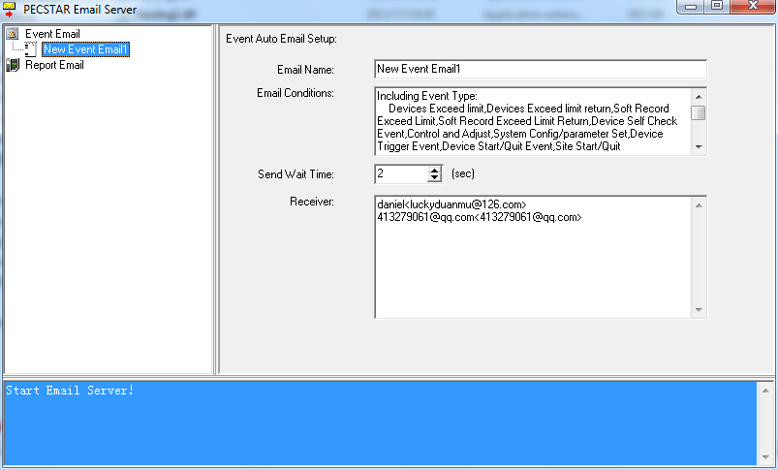
SOP for Configuring Auto-mail Alarm
The Email details are shown in the panel and Start Email Server! in Pecsmail panel means Pecsmail is ready to send email.

Slide 11
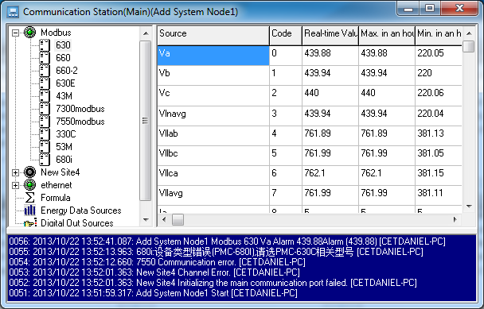
SOP for Configuring Auto-mail Alarm
When the alarm is triggered, one alarm message shows up in Front panel.

Slide 12
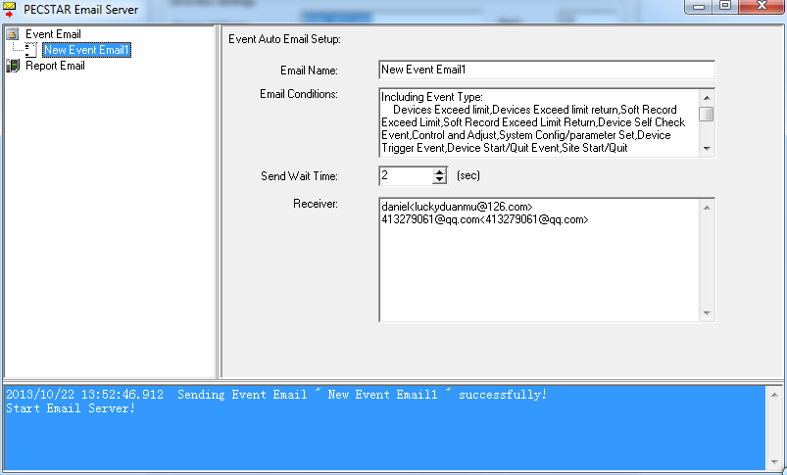
SOP for Configuring Auto-mail Alarm
The message of successfully sending event email shows up in Pecsmail panel as well.
The email can be received in a few seconds.

Slide 13
SOP for Configuring Auto-mail Alarm
Thank you!!!

